Slide 1
Projects
1. Pantomime with and without vocalization (Zlatev)
2. Understanding communicative signs by domestic animals? (Zlatev)
3. Understanding referential iconicity in music (Zlatev)
4. Children’s ability to interpret pictures (Sonesson)
5. The indexicality of pictures (Sonesson)
6. Visual rhetoric (Sonesson)

Slide 2
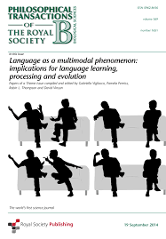
1. Pantomime with and without vocalization
“Multimodal” accounts of language origins assume that
visually perceived signs expressed with the body
and heard signs/signals produced by the vocal apparatus
blended seamlessly in the transition from pre-linguistic to linguistic communication, from the start of this process around 1-2 MYA.

Slide 3
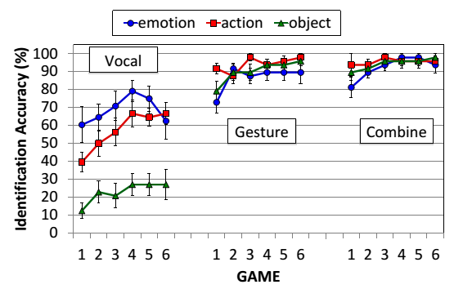
1. Pantomime with and without vocalization (cont)
However, recent studies (Fay et al. 2013, Fay et al. 2014, Zlatev et al., 2017), have not found evidence for any communicative advantage for multimodal compared to “unimodal” gesture/pantomime (without vocalization).
While there is evidence that non-verbal vocalizations express emotional information, this did not help in the communicative tasks.

Slide 4
1. Pantomime with and without vocalization (cont)
The goal of this project is to test if these conclusions hold after changing the design of the experiment in one of several possible ways.
One is to make the communication between sender and receiver “live” rather than mediated through video-recordings. A version of this is to make the task interactive, that is, to allow sender and receiver to change roles every second trail.
Another is to change the representation of the events to be communicated (it was pictorial in the Zlatev et al study, but this may have contributed to many accidental details in the re-enactments.)

Slide 5
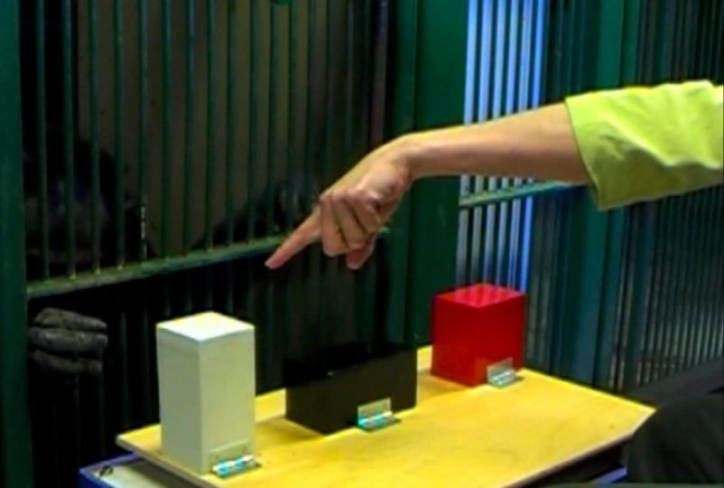
2. Understanding communicative signs by domestic animals?
Human children solve the “object choice task” – where a communicator indicates in which one of several containers a reward is hidden, by means of different kinds of signals/signs – much easier than chimpanzees (and other great apes).
Hence, it has been proposed that human beings possess some pre-linguistic cognitive-semiotic capacity, such as joint intentionality (Tomasello) or bodily mimesis (Donald, Zlatev), which is unique, at least among the primates

Slide 6
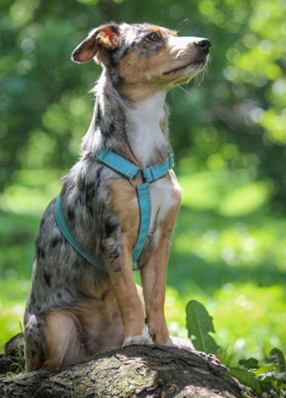
2. Understanding communicative signs by domestic animals?
Hare & Tomasello (2005) show that ordinary family dogs, irrespective of race, perform surprisingly well in such tasks, following points and other indexical signs, and not only when the communicator is their owner.
A plausible explanation of this is domestication: over ca. 18 000 years of symbiotic co-existence dogs have evolved capacities that allow them to understand human intentions, expressed through gestures and vocal signals. Perhaps a similar logic can be applied to semi-domesticated animals like cats?
How far such capacities stretch? Could dogs and cats have evolved the capacity to understand signs, even though their linguistic skills are admittedly limited (especially in production)? Could the be shown to understand more than indexical signs?

Slide 7
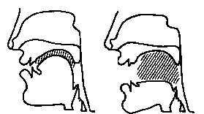
3. Understanding referential iconicity in music
Jakobson (1965) was one of the first to argue that Saussure was mistaken on the fundamental “arbitrariness” of the linguistic sign, as many if not most linguistic signs resemble their meanings, most often in subtle ways. In semiotic terms, they display different forms, and different degrees of iconicity.
Further, this is not only some evolutionary relic, as speakers can utilize such resemblance/iconicity to figure out the meanings of unknown words, either invented, or in languages that they do not speak. Further, this applies to children as well as adults (Imai & Kita 2014).

Slide 8
3. Understanding referential iconicity in music
But such iconic reference is by no means limited to speech, as it characterizes some forms/elements in music as well, as in so called “programmatic music”.
But are unskilled listeners capable of discerning such (abstract) resemblances, especially before they are pointed out to them? In other words, is this is a matter of “primary” rather than “secondary” iconicity (Sonesson 2010; Ahlner & Zlatev 2010)?

Slide 9
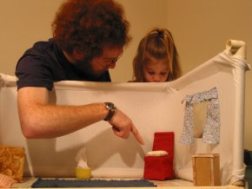
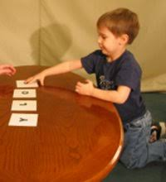
4. Children’s ability to interpret pictures
To interpret a picture, it is not enough to see it as similar to something, but you must also understand that it is not simply a member of the category of objects to which it is similar. Infants and many animals clearly accomplish the first task. Yet, interpreting pictures in the full sense appears to be surprisingly difficult: experiments by DeLoache and her collaborators (e.g. DeLoache and Burns 1994) suggest that pictures are understood later than language (around 2.5 years) while scale models are even more difficult to understand than pictures (around 3 years).

Slide 10
4. Children’s ability to interpret pictures
In order to check that children understood the function of the picture, DeLoache had them retrieve a hidden object in another room, which they had seen in a picture. Lenninger (2009; 2012) eliminated the element of hiding and realised the experiment in a familiar environment, and yet did not find any essentially better result.
However, the idea that pictures simply have the function of designating an object in the real world may be too simple. In fact, children’s first acquaintance with pictures, as well as with the object depicted, may very well occur with the “reading” of picture books.

Slide 11
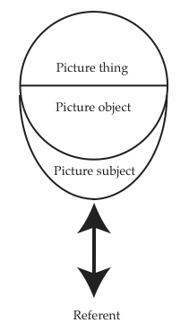
4. Children’s ability to interpret pictures
In a pilot study, Lenninger found that children could much earlier identify one object they had seen in one picture when it appeared in another picture. If this is going to show that children understand pictures, without being able to localise their referents, we must be sure that the children still understand that the picture is not the object. In other terms, they must identify the picture object, not the picture thing (Cf. Sonesson & Lenninger 2015)

Slide 12
4. Children’s ability to interpret pictures
Tasks: Set up an experiment with children that would allow us to conclude that there is some sense in which children who are unable to find the referent of a depicted object can still be said to understand the picture, without confusing the picture and the object. How would you vary the way the objects appear in the different pictures in order to be sure that the picture object, and not just the picture thing, has been identified? Suggest several possible variations.
A complicating factor is that you normally need to apply for a special permit to experiment on children. We shall treat this as a pilot study, which is to say a study in which you try out the experimental set-up. In these conditions, you may engage children of friends and neighbours, and you only need a couple of children for each age group.

Slide 13
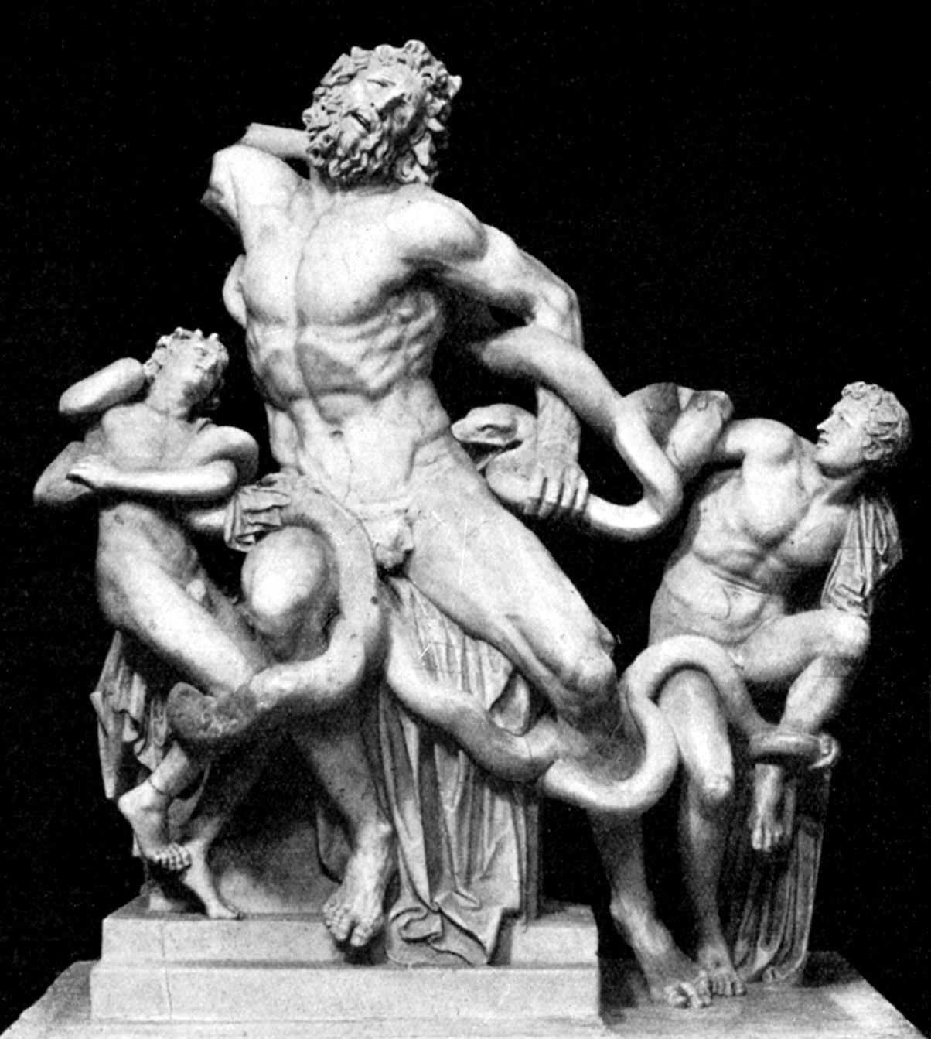
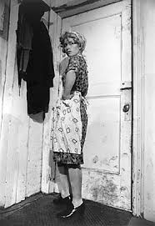
5. The indexicality of pictures
Hribar, Sonesson, & Call 2014 studied the ability of the chimpanzee Alex to recognize some simple bodily movements, when conveyed by different media. Here we will be interested in one particular sub-task of this experiment, in which we compared complete video recordings with static pictures, either of the final moment of the movement, or of the penultimate moment.

Slide 14
5. The indexicality of pictures
The distinction was inspired by the work of the German 18th century proto-semiotician Gotthold Ephraim Lessing, who claimed that, unlike language, pictures could not render events, but only objects, and that events could be indicated indirectly in pictures more favourably when choosing the penultimate moment than the final one, since the former, rather than the latter, was “pregnant” with the whole event.
In our study, we found that, to Alex, both the final and the penultimate moments of the event allowed for just as easy an identification of the event, and that they both did that just as well as the complete event recording

Slide 15
5. The indexicality of pictures
Since this is certainly the kind of skill (unlike tree climbing) that human beings tend to do better than apes, it seems plausible that something similar is true of human beings, but, as far as we know, the theory has never been tested with the latter.

Slide 16
5. The indexicality of pictures
Your task as to make a pilot study of human beings identifying events from perceiving them in the real world, seeing them in a complete video recording, or in different statically rendered phases of the event. The relevant sense of the notion of pilot study here employed is that you should try out the experimental set-up, rather than making a publishable study, which means that you only need a couple of subjects (who could be adults).

Slide 17
5. The indexicality of pictures
The criterion for recognition could be the imitation of the event, as in the Alex case, but with human beings, it is possible to think of other criteria. You should not forget to make a phenomenological analysis of the experimental situation presented in the above-mentioned study, in order to find out whether the choice of events may have been biasing the result of the study, in which case you might want to pick different categories of events.

Slide 18
6. Visual rhetoric
Metaphors, and other kinds of rhetorical figures, are usually considered to be something occurring in the verbal domain exclusively, but during the phase of French structuralism, in the sixties and seventies of the last century, several thinkers tried to apply this idea to other domains, and notably to pictures.
The most systematic approach was that of the Belgian group µ, but more recently the theme has aroused interest in other quarters, in particular within the study of advertisements as well in multimodality studies, such as the work of Forceville, Bolognesi, etc.

Slide 19
6. Visual rhetoric
At present, however, metaphors are usually understood in the sense of Lakoff, who generalized the notion of metaphor well beyond the classical property of creating an effect of surprise.
In particular when studying pictorial metaphors, it will be necessary to return to the classical definition of metaphors as featuring at state of tension and/or the production of an unexpected presence and/or absence.
What Lakoff and his followers call metaphors will be considered a much deeper level of cognition which, among other things, contain resources for metaphors.

Slide 20
6. Visual rhetoric
Sonesson has tried to revise the Group µ model in several papers, in order to make it more phenomenologically relevant.
In the final lecture, we will present some new considerations, which we think will help to understand the nature of pictorial metaphor (and, perhaps, other rhetorical figures), taking into account the difference between performative and abductive indexicality, which are at the root of metonymies.
However, if metonymies tend to be used in pictorial rhetoric as building blocks of metaphors, the questions becomes whether metonymies also have any independent function.

Slide 21
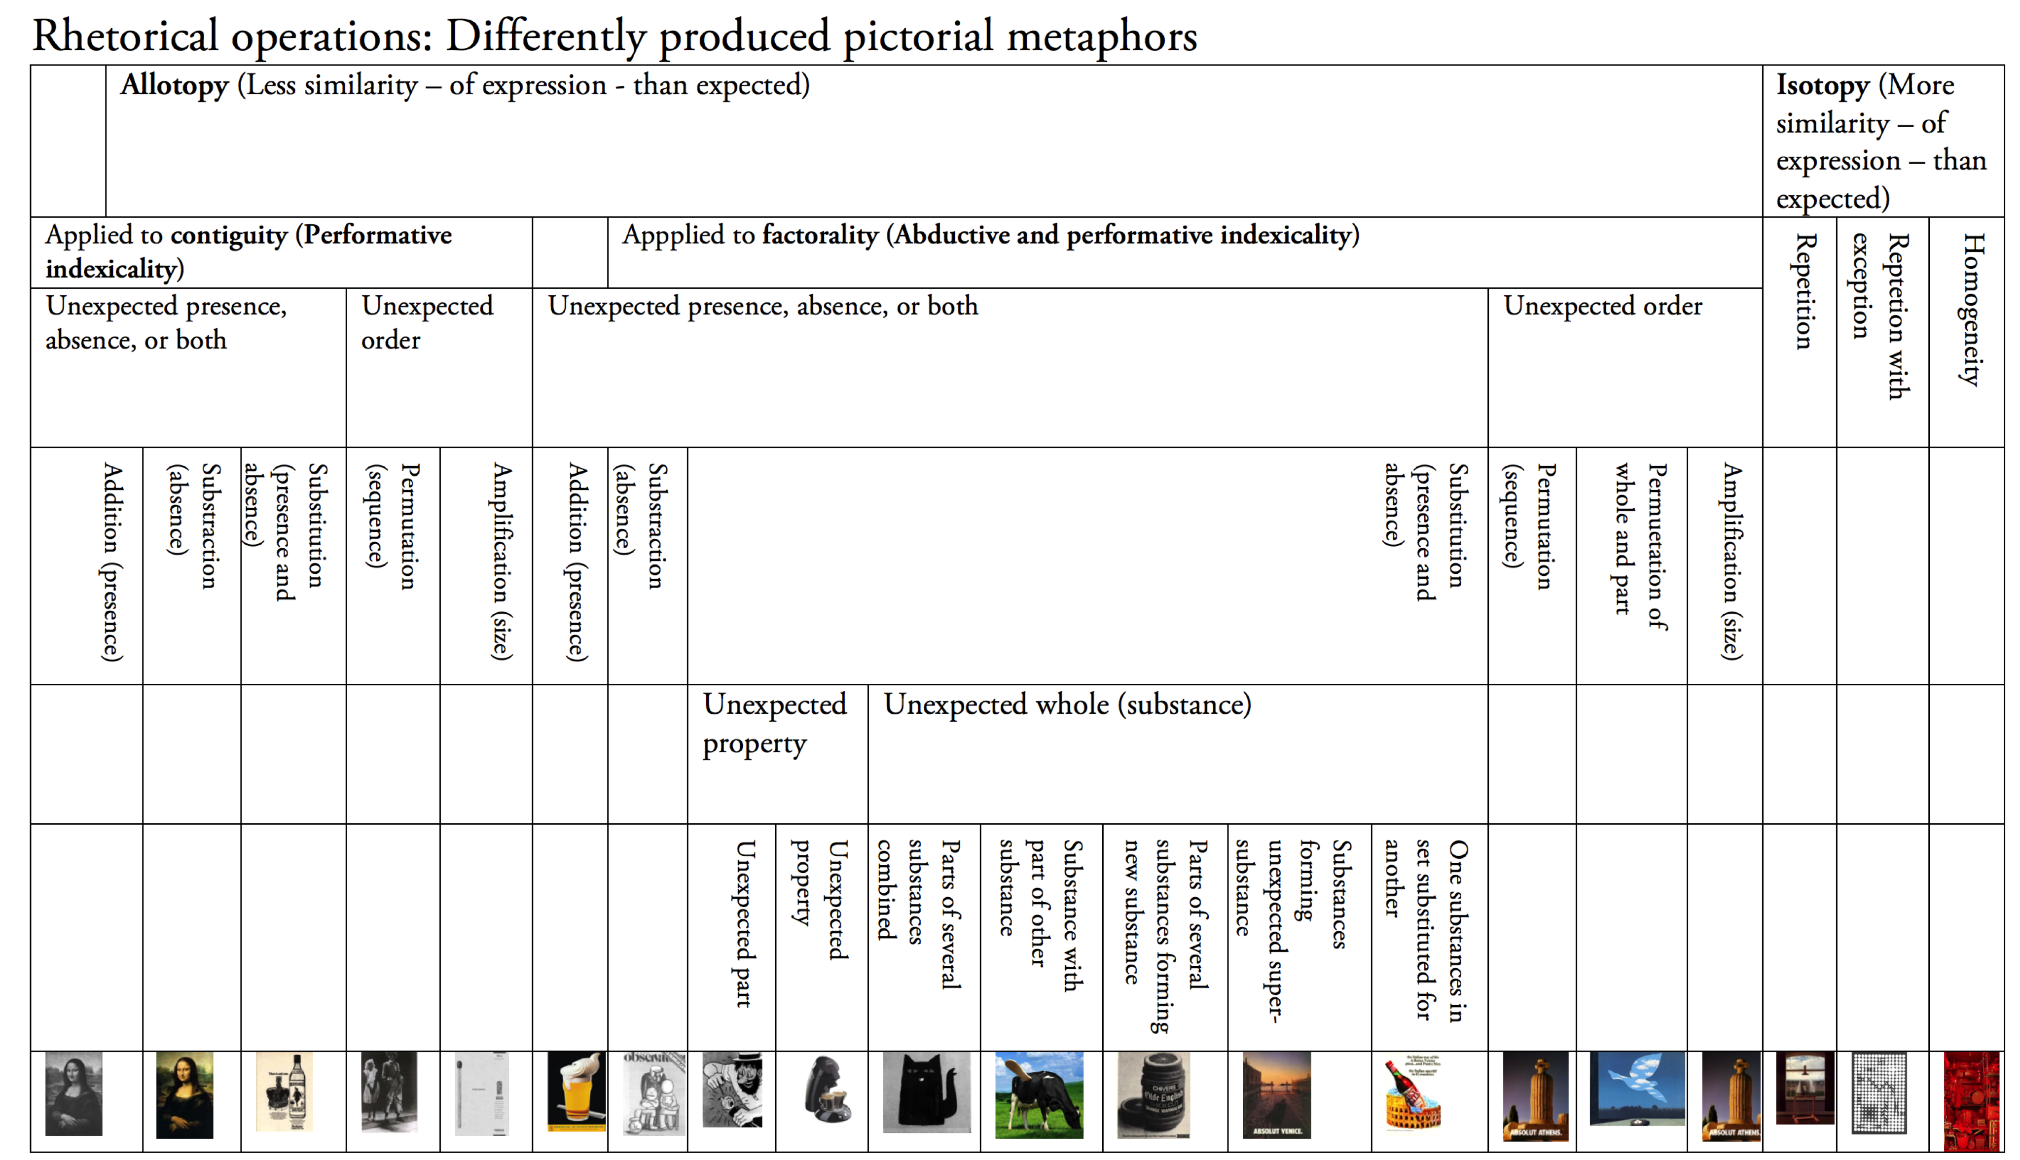
6. Visual rhetoric

Slide 22
6. Visual rhetoric
The above-mentioned studies of pictorial metaphors with reference to advertisements and multimodality may not be as explicit and detailed at the Groupe µ system, or as our derived system, but they have the great advantage of being based on pictorial databases.
Some of the relevant databases can be found here:
VisMet is a project on visual metaphors hosted by the Metaphor Lab (VU University Amsterdam). Project: http://www.vismet.org/VisMet/display.php
CogVim (Cognitive Grounding of Visual Metaphor) is a Marie Curie project: https://cogvim.org
EMMA is a research project in metaphor and metonymy hosted by the University of Birmingham: http://www.birmingham.ac.uk/schools/business/research/research-projects/emma.aspxhttps://multimodalmetaphor.com

Slide 23
6. Visual rhetoric
Your task is to use one or several of the databases using the categories of the schema presented during the lecture, and considering its possible amplifications.
It is of course impossible for you to analyse all the pictures contained in even one of these databases, so you need to define a criterion for picking some of these pictures, and ignoring others.
Of course, this choice should be made in a way not to bias the answers to the questions formulated above.

Slide 24
Assignment on Luvit
By Nov 7, 3pm, list three projects you would wish to work on in order of preference, like this
Project X “Name”
Project Y “Name”
Project Z “Name”
We will form 6 groups with more or less equal number of participants, on the basis of these preferences

